Slide 1

ES038
TECHNOPRENEURSHIP

Slide 2
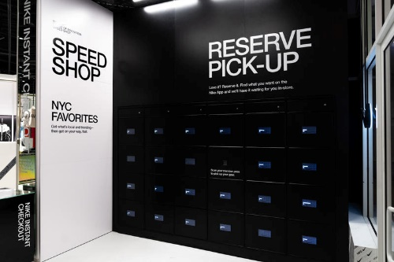
Nike’s Speed Shop
Flagship store in New York City
Called the Nike House of Innovation 000
Create impressive and highly convenient
experience for shoppers

Slide 3
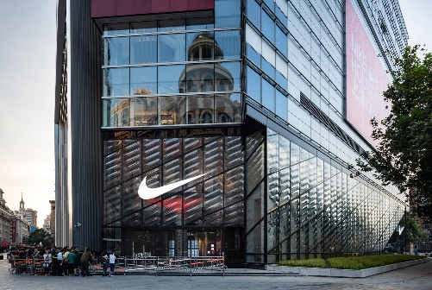
Nike’s Speed Shop
The first Nike House of Innovation 001 was
opened in Shanghai.
It was then followed by Nike House of
Innovation 000 in New York.
This shops offer exclusive products in
different Cities.

Slide 4
Nike’s Speed Shop
Nike went through critical points at first, but
sees challenges as nothing so they receive
so many good feedbacks about it.
One of the insights from the costumer:
New York’s HOI 000 is a fun and
engaging retail experience that blows
others out of the water in how it puts
customers and their needs first. But
the best bits were by far those that
offered customized, participatory
experiences, not those that sold
clothes or shoes.

Slide 5
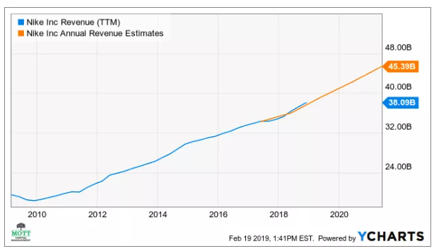
Nike’s Speed Shop
Because of the innovation, Nike has
maintained their growing market up to this
day.
They didn’t stop when they saw the growth.
They even found a way to have a stable
growth as you can see in between 2018 to
2020, where implementing the innovation
happened in 2018.

Slide 6
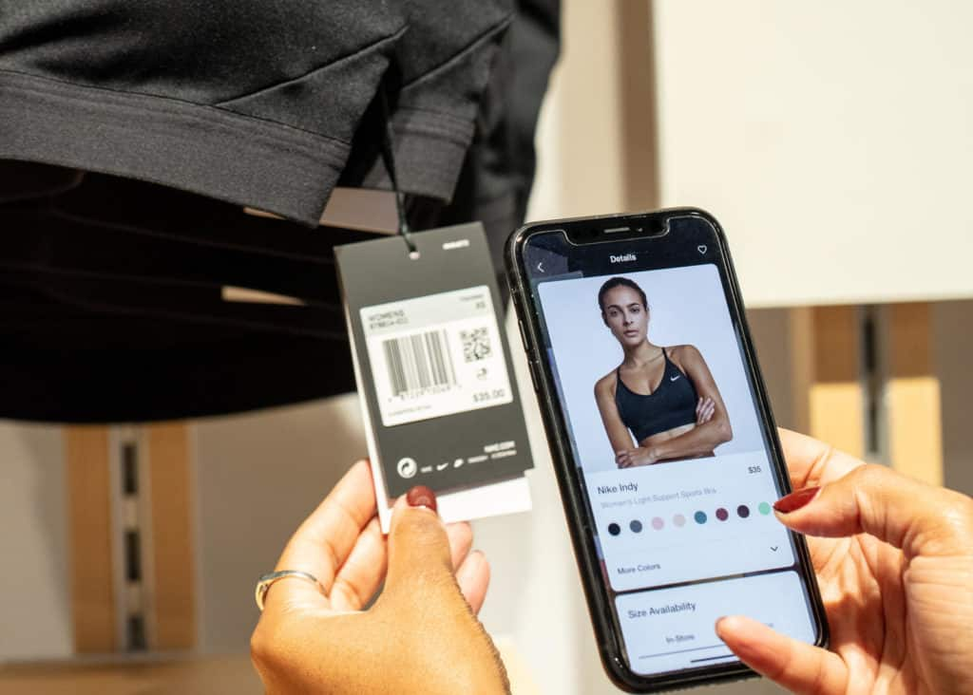
Nike’s Speed Shop
Payment options can be either cash or by
mobile checkout where you don’t need to
queue to pay.
The best thing about the innovation
costumers can reserve shoes online to try
in-store and find the locker with your name
which can be unlocked via smartphone.

Slide 7

Nike’s Speed Shop
Success factors:
Invest in marketing
Promote products through famous
celebrities, professionals and athletes.
Sponsorships, internet marketing, email
marketing and utilized multimedia
Respond to competition

Slide 8
Nike’s Speed Shop
Success factors:
Utilize emotional branding
Co-brands with various sports and
top athletes.
Maximizes marketing money with
sports endorsements
Utilize social media

Slide 9
2019, January 15. Retrieved from https://mediu
m.com/out-of-space/5-4-retail-case-study-nike
s-house-of-innovation-f315338fce49
Nike’s Speed Shop
Sources:
Kramer, M.J. 2019, February 20. Retrieved
from https://www.investopedia.com/nike-s-
digital-revival-may-pave-the-way-for-big-sale
-growth-in-2019-4587432.

Slide 10
Gilliland, N. 2019, January 23. Retrieved from
https://econsultancy.com/examples-digital-tech
nology-in-retail-stores/
Nike’s Speed Shop
Sources:
Retrieved from https://profitworks.ca/blog/ma
rketing-strategy/545-nike-strategy-how-nike-
became-successful-and-the-leader-in-the-sports
-product-market.html

